Slide 1
Part 2: More on the Mahalanobis Distance

Slide 2
Outline
Motivation and Basic Concepts
Metric Learning tasks where it’s useful to learn dist. metric
Overview of Dimensionality Reduction
Mahalanobis Metric Learning for Clustering with Side Info (Xing et al.)

Slide 3
Motivation
Many problems may lack a well-defined, relevant distance metric
Incommensurate features  Euclidean distance not meaningful
Side information  Euclidean distance not relevant
Learning distance metrics may thus be desirable
A sensible similarity/distance metric may be highly task-dependent or semantic-dependent
What do these data points “mean”?
What are we using the data for?

Slide 4







Which images are most similar?

Slide 5



It depends ...
right
centered
left

Slide 6
male
female
It depends ...

Slide 7
... what you are looking for
student
professor

Slide 8
... what you are looking for
nature background
plain background

Slide 9



Mahalanobis distance metric
The simplest mapping is a linear transformation

Slide 10



Mahalanobis distance metric
The simplest mapping is a linear transformation
Algorithms can
learn both
matrices
PSD

Slide 11
Introduction to Dimensionality Reduction

Slide 12

How can the dimensionality be reduced?
eliminate redundant features
eliminate irrelevant features
extract low dimensional structure

Slide 13



Notation
Input:
with
Output:
Embedding principle:
Nearby points remain nearby,
distant points remain distant.
Estimate r.

Slide 14

Linear dimensionality reduction

Slide 15
Principal Component Analysis
(Jolliffe 1986)
Project data into subspace
of maximum variance.

Slide 16

Optimization

Slide 17
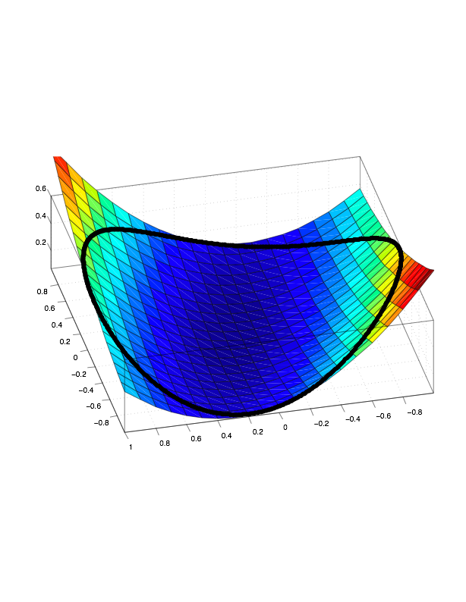

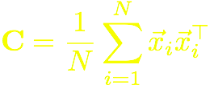
Optimization
Eigenvalue solution:
Covariance
matrix

Slide 18

Facts about PCA
Eigenvectors of covariance matrix C
Minimizes ssq reconstruction error
Dimensionality r can be estimated from eigenvalues of C
PCA requires meaningful scaling of input features

Slide 19
Mahalanobis Distance
Explanatory: {x_{i} , i=1,…,N} plus two types of side info:
“Similar” set S = { (x_{i} , x_{j} ) } s.t. x_{i} and x_{j} are “similar” (e.g. same class)
“Dissimilar” set D = { (x_{i} , x_{j} ) } s.t. x_{i} and x_{j} are “dissimilar”
Learn optimal Mahalanobis matrix M
D²_{ij} = (x_{i} – x_{j})^{T} M (x_{i} – x_{j}) (global dist. fn.)
Goal : keep all pairs of “similar” points close,
while separating all “dissilimar” pairs.
Formulate a mathematical programming problem
minimize the distance between the data pairs in S
Subject to data pairs in D are well separated

Slide 20
Mahalanobis Distance
Objective of learning:
M is positive semi-definite
Ensure non negativity and triangle inequality of the metric

Slide 21

Mahalanobis Metric

Slide 22
Mahalanobis Metric
Move similarly labeled inputs together

Slide 23
Mahalanobis Metric
Move different labeled inputs apart

Slide 24


Another math programming problem

Slide 25
math programming problem
target: Mahalanobis matrix

Slide 26
math programming problem
pushing
differently
labeled
inputs apart

Slide 27
math programming problem
pulling
similar
points
together

Slide 28
math programming problem
ensuring positive
semi-definiteness

Slide 29
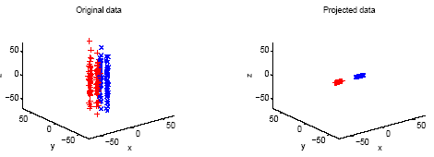
Mahalanobis Metric Learning: Example I
Data Dist. of the original dataset
(b) Data scaled by the global metric
Keep all the data points within the same classes close
Separate all the data points from different classes

Slide 30
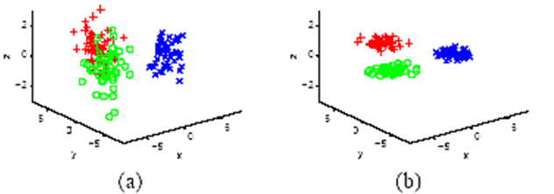
Mahalanobis Metric Learning: Example II
Original data
(b) rescaling by learned full M

